Slide 1
Machine Learning
Machine learning is a subset of AI, which enables the machine to automatically learn from data, improve performance from past experiences, and make predictions.
Machine learning contains a set of algorithms that work on a huge amount of data. Data is fed to these algorithms to train them, and on the basis of training, they build the model & perform a specific task.
These ML algorithms help to solve different business problems like Regression, Classification, Forecasting, Clustering, and Associations, etc.

Slide 2
Types
Based on the methods and way of learning, machine learning is divided into mainly four types, which are:
Supervised Machine Learning
Unsupervised Machine Learning
Semi-Supervised Machine Learning
Reinforcement Learning

Slide 3
1. Supervised Machine Learning
As its name suggests, Supervised machine learning is based on supervision.
It means in the supervised learning technique, we train the machines using the "labelled" dataset, and based on the training, the machine predicts the output.
Here, the labelled data specifies that some of the inputs are already mapped to the output.
More preciously, we can say; first, we train the machine with the input and corresponding output, and then we ask the machine to predict the output using the test dataset.

Slide 4
Example:
Suppose we have an input dataset of cats and dog images. So, first, we will provide the training to the machine to understand the images, such as the shape & size of the tail of cat and dog, Shape of eyes, colour, height (dogs are taller, cats are smaller), etc.
After completion of training, we input the picture of a cat and ask the machine to identify the object and predict the output. Now, the machine is well trained, so it will check all the features of the object, such as height, shape, colour, eyes, ears, tail, etc., and find that it's a cat. So, it will put it in the Cat category. This is the process of how the machine identifies the objects in Supervised Learning.
The main goal of the supervised learning technique is to map the input variable(x) with the output variable(y). Some real-world applications of supervised learning are Risk Assessment, Fraud Detection, Spam filtering, etc.

Slide 5
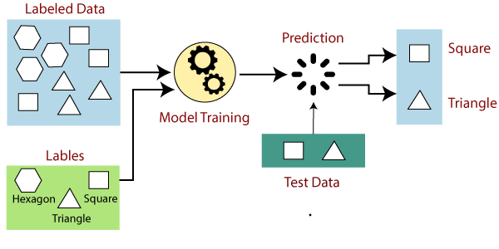

Slide 6
Categories of Supervised Machine Learning
Supervised machine learning can be classified into two types of problems, which are given below:
Classification
Regression

Slide 7
a) Classification
Classification algorithms are used to solve the classification problems in which the output variable is categorical, such as "Yes" or No, Male or Female, Red or Blue, etc. The classification algorithms predict the categories present in the dataset. Some real-world examples of classification algorithms are Spam Detection, Email filtering, etc.
Some popular classification algorithms are given below:
Random Forest Algorithm
Decision Tree Algorithm
Logistic Regression Algorithm
Support Vector Machine Algorithm

Slide 8
Types of classification
Binary Classification: When we have to categorize given data into 2 distinct classes. Example – On the basis of given health conditions of a person, we have to determine whether the person has a certain disease or not.
Multiclass Classification: The number of classes is more than 2. For Example – On the basis of data about different species of flowers, we have to determine which specie does our observation belongs to.

Slide 9
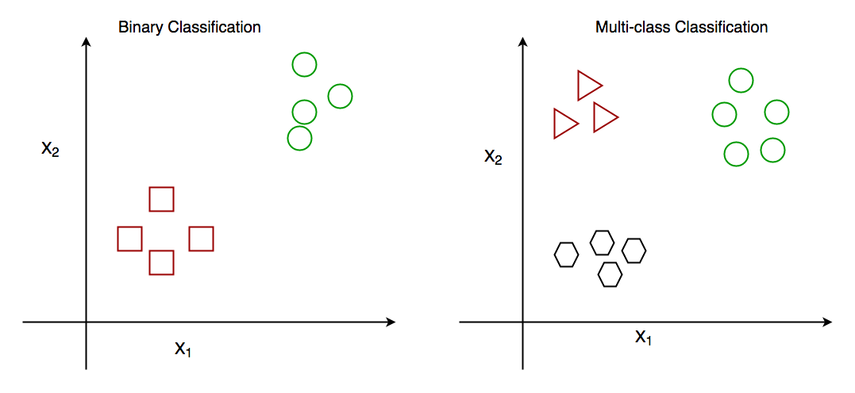

Slide 10
b) Regression
Regression algorithms are used to solve regression problems in which there is a linear relationship between input and output variables. These are used to predict continuous output variables, such as market trends, weather prediction, etc.
Some popular Regression algorithms are given below:
Simple Linear Regression Algorithm
Multiple Linear Regression Algorithm

Slide 11
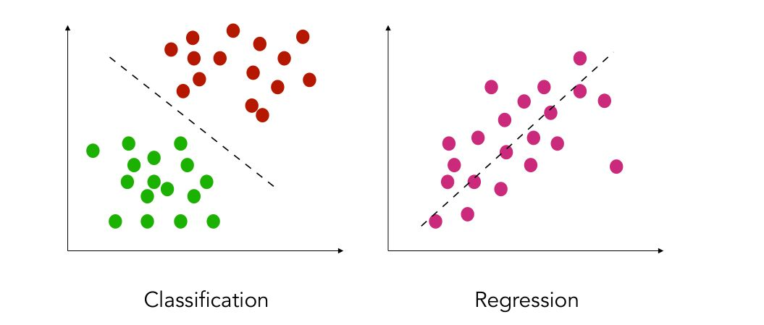

Slide 12
Advantages and Disadvantages of Supervised Learning
Advantages:
Since supervised learning work with the labelled dataset so we can have an exact idea about the classes of objects.
These algorithms are helpful in predicting the output on the basis of prior experience.
Disadvantages:
These algorithms are not able to solve complex tasks.
It may predict the wrong output if the test data is different from the training data.
It requires lots of computational time to train the algorithm.

Slide 13
Applications of Supervised Learning
Image Segmentation: Supervised Learning algorithms are used in image segmentation. In this process, image classification is performed on different image data with pre-defined labels.
Medical Diagnosis: Supervised algorithms are also used in the medical field for diagnosis purposes. It is done by using medical images and past labelled data with labels for disease conditions. With such a process, the machine can identify a disease for the new patients.
Fraud Detection - Supervised Learning classification algorithms are used for identifying fraud transactions, fraud customers, etc. It is done by using historic data to identify the patterns that can lead to possible fraud.
Spam detection - In spam detection & filtering, classification algorithms are used. These algorithms classify an email as spam or not spam. The spam emails are sent to the spam folder.
Speech Recognition - Supervised learning algorithms are also used in speech recognition. The algorithm is trained with voice data, and various identifications can be done using the same, such as voice-activated passwords, voice commands, etc.

Slide 14
2. Unsupervised Machine Learning
Unsupervised learning is different from the Supervised learning technique; as its name suggests, there is no need for supervision. It means, in unsupervised machine learning, the machine is trained using the unlabeled dataset, and the machine predicts the output without any supervision.
In unsupervised learning, the models are trained with the data that is neither classified nor labelled, and the model acts on that data without any supervision.
The main aim of the unsupervised learning algorithm is to group or categories the unsorted dataset according to the similarities, patterns, and differences. Machines are instructed to find the hidden patterns from the input dataset.

Slide 15
Example:
Suppose there is a basket of fruit images, and we input it into the machine learning model. The images are totally unknown to the model, and the task of the machine is to find the patterns and categories of the objects.
So, now the machine will discover its patterns and differences, such as colour difference, shape difference, and predict the output when it is tested with the test dataset.

Slide 16
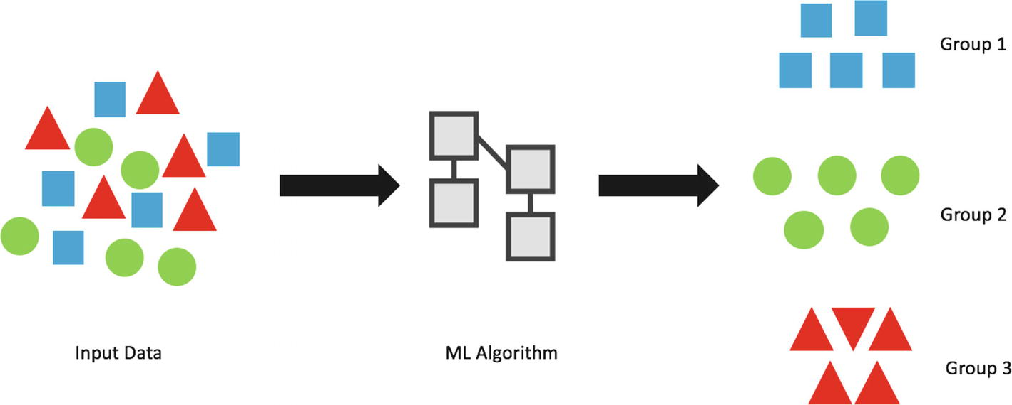

Slide 17
Categories of Unsupervised Machine Learning
Unsupervised Learning can be further classified into two types, which are given below:
Clustering
Association

Slide 18
1) Clustering
The clustering technique is used when we want to find the inherent groups from the data. It is a way to group the objects into a cluster such that the objects with the most similarities remain in one group and have fewer or no similarities with the objects of other groups.
An example of the clustering algorithm is grouping the customers by their purchasing behaviour.
Some of the popular clustering algorithms are given below:
K-Means Clustering algorithm
DBSCAN Algorithm

Slide 19
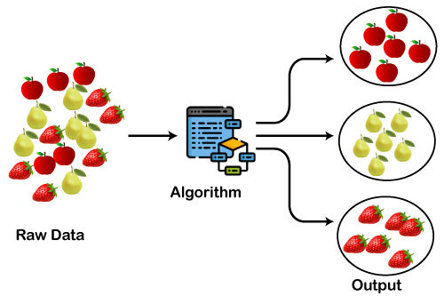

Slide 20
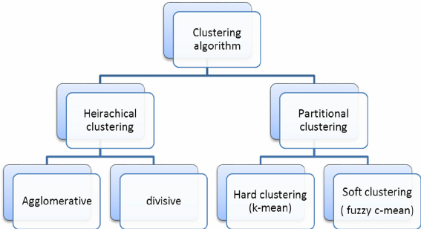
Types of Clustering

Slide 21
2) Association
Association rule learning is an unsupervised learning technique, which finds interesting relations among variables within a large dataset.
The main aim of this learning algorithm is to find the dependency of one data item on another data item and map those variables accordingly so that it can generate maximum profit.
This algorithm is mainly applied in Market Basket analysis, Web usage mining, continuous production, etc.
Some popular algorithms of Association rule learning are Apriori Algorithm, Eclat, FP-growth algorithm.

Slide 22
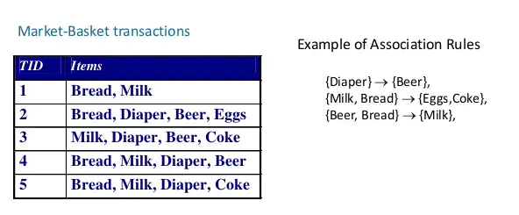
Example

Slide 23
Advantages and Disadvantages of Unsupervised Learning Algorithm
Advantages:
These algorithms can be used for complicated tasks compared to the supervised ones because these algorithms work on the unlabeled dataset.
Unsupervised algorithms are preferable for various tasks as getting the unlabeled dataset is easier as compared to the labelled dataset.
Disadvantages:
The output of an unsupervised algorithm can be less accurate as the dataset is not labelled, and algorithms are not trained with the exact output in prior.
Working with Unsupervised learning is more difficult as it works with the unlabelled dataset that does not map with the output.

Slide 24
Applications of Unsupervised Learning
Recommendation Systems: Recommendation systems widely use unsupervised learning techniques for building recommendation applications for different web applications and e-commerce websites.
Anomaly Detection: Anomaly detection is a popular application of unsupervised learning, which can identify unusual data points within the dataset. It is used to discover fraudulent transactions.

Slide 26
3. Semi-Supervised Learning
Semi-Supervised learning is a type of Machine Learning algorithm that lies between Supervised and Unsupervised machine learning.
It represents the intermediate ground between Supervised (With Labelled training data) and Unsupervised learning (with no labelled training data) algorithms and uses the combination of labelled and unlabeled datasets during the training period.
It operates on the data that consists of a few labels, it mostly consists of unlabeled data. As labels are costly, but for corporate purposes, they may have few labels.
It is completely different from supervised and unsupervised learning as they are based on the presence & absence of labels.

Slide 27
To overcome the drawbacks of supervised learning and unsupervised learning algorithms, the concept of Semi-supervised learning is introduced.
The main aim of semi-supervised learning is to effectively use all the available data, rather than only labelled data like in supervised learning. Initially, similar data is clustered along with an unsupervised learning algorithm, and further, it helps to label the unlabeled data into labelled data. It is because labelled data is a comparatively more expensive than unlabeled data.
Example: Supervised learning is where a student is under the supervision of an instructor at home and college. Further, if that student is self-analysing the same concept without any help from the instructor, it comes under unsupervised learning. Under semi-supervised learning, the student has to revise himself after analysing the same concept under the guidance of an instructor at college.

Slide 28
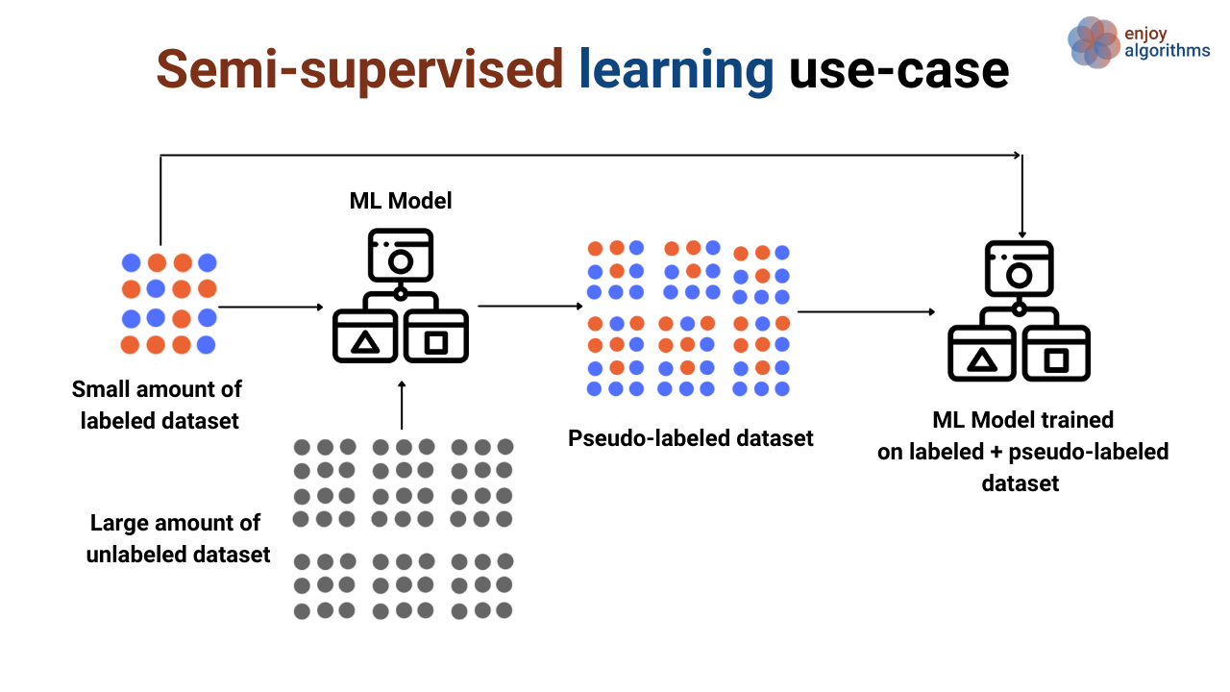

Slide 29
Advantages and disadvantages of Semi-supervised Learning
Advantages:
It is simple and easy to understand the algorithm.
It is highly efficient.
It is used to solve drawbacks of Supervised and Unsupervised Learning algorithms.
Disadvantages:
Iterations results may not be stable.
We cannot apply these algorithms to network-level data.
Accuracy is low.

Slide 30
4. Reinforcement Learning
Reinforcement learning works on a feedback-based process, in which an AI agent (A software component) automatically explore its surrounding by hitting & trail, taking action, learning from experiences, and improving its performance.
Agent gets rewarded for each good action and get punished for each bad action; hence the goal of reinforcement learning agent is to maximize the rewards.
In reinforcement learning, there is no labelled data like supervised learning, and agents learn from their experiences only.
The reinforcement learning process is similar to a human being; for example, a child learns various things by experiences in his day-to-day life. An example of reinforcement learning is to play a game, where the Game is the environment, moves of an agent at each step define states, and the goal of the agent is to get a high score. Agent receives feedback in terms of punishment and rewards.

Slide 31


Slide 32
Real-world Use cases of Reinforcement Learning
Video Games: RL algorithms are much popular in gaming applications. It is used to gain super-human performance. Some popular games that use RL algorithms are AlphaGO and AlphaGO Zero.
Robotics: RL is widely being used in Robotics applications. Robots are used in the industrial and manufacturing area, and these robots are made more powerful with reinforcement learning. There are different industries that have their vision of building intelligent robots using AI and Machine learning technology.

Slide 33
Advantages and Disadvantages of Reinforcement Learning
Advantages
It helps in solving complex real-world problems which are difficult to be solved by general techniques.
The learning model of RL is similar to the learning of human beings; hence most accurate results can be found.
Helps in achieving long term results.
Disadvantage
RL algorithms are not preferred for simple problems.
RL algorithms require huge data and computations.
Too much reinforcement learning can lead to an overload of states which can weaken the results.

